Slide 1
Foster Care Tuition Waivers: How do they work, who benefits, and what is missing?
Angelique Day, PhD, MSW
Liliana Hernandez, MSW & MPP
2018 Passport to College
State Conference
Tacoma, WA

Slide 2
How many youth in foster care pursue post-secondary education?
Notes:
70% of foster youth between the ages of 15 and 19 have college aspirations, In this respect, they are like their non-foster care peers (Venezia & Jaeger, 2013); however, according to Courtney (2009), only 20% ever enroll in college and of those, only between three and nine percent earn a bachelor’s degree (Cohen, 2014; Pecora, et al., 2006).

Slide 3
Challenges Faced by Youth in Care
K-12 Readiness Barriers
School/placement instability
Grade repetition, lower testing scores, higher rates of Special Education
Few engaged in precollege programs/lack of internships/
Lack of counseling - financial aid and college applications
Impact of being in foster care on one’s self determination, identity formation and achieving normal developmental milestones
Higher Education Barriers
Remedial classes, fin aid limits, Lack of awareness of fin aid programs lack of college advocates
Housing/homelessness during college breaks
Health issues, Substance Abuse/Mental Health, Learning Disabilities
Lack of family support, Trust/Attachment issues/ Independent- survival mode
Few college programs are aware of their support needs
Notes:
Foster youth who do not enroll in college point to cost and lack of financial aid as the primary obstacles. Tuition is a formidable barrier to postsecondary education as young people in foster care are disproportionately low-income and often lack financial and emotional support from parents and other family members typically provided to their non-foster care peers, often well into their twenties.
Other barriers include:
Due to school mobility issues, only 58% of foster care youth graduate from high school by age 19 as compared to 87% of a comparison group of non-foster youth (Courtney et al., 2007; National Youth in Transition Database, 2014), which makes them unlikely to graduate from college by the age of 23. Currently, students are losing access to critical financial aid resources in the middle of their college journeys, forcing some students to drop out of college prematurely in seek of employment (GAO, 2016).

Slide 4
Passport to College Scholarship
340 students received in 2017, $4,500 max award.
Eligibility Requirements
Former foster child was in care for at least 1yr after age 16
Emancipate from care on or after January 1, 2007.
Enroll at least half-time in an eligible college by their 22nd birthday.
Maintain Washington residency.
Be working toward earning their first bachelor’s degree, associate degree, or certificate- not purse a theology degree.
Data exchange enables verification of student eligibility
http://www.readysetgrad.org/college/passport-foster-youth-promise-program
Notes:
EX: if student graduates HS at age 18- must apply within 3yrs- at 21 or if student leaves care at age 21- must apply by 24.
Age 14 info included in the FAQ page:
https://testofyc.files.wordpress.com/2013/06/tuition-waiver-faqs1.pdf- check OR answers
State Treasury Fund-Former Foster Youth Scholarship Fund –appropriated to the Oregon Student Assistance Commission
Rest in legislation-
State Treasury Fund-Former Foster Youth Scholarship Fund –appropriated to the Oregon Student Assistance Commission

Slide 5
Passport to College Scholarship
2SSB 6274 expanded the Passport program in two ways: broadened eligibility and provides additional programming:
Eligibility: expanded to include students who were in the care of the state foster care system, tribal foster care system, or federal foster care system in Washington state at any time before age twenty-one subsequent to the following:
- Age fifteen as of July 1, 2018;
- Age fourteen as of July 1, 2019; and
- Age thirteen as of July 1, 2020;
- Or, beginning July 1, 2019, were verified on or after July 1st of the prior academic year as an unaccompanied youth experiencing homelessness, before age twenty-one.
Additional Programming:
Apprenticeships: establishes a programmatic pathway to support students pursuing apprenticeships – The Passport to Apprenticeship Opportunities program.

Slide 6
Passport Supportive Services
47 colleges have a Passport Viable plan.
Supportive Services include:
Paid Tutors for Passport to College students
Private Computer lab for passport students
Lending library for textbooks, laptops, calculators,
Dorm room supplies
Transportation assistance
Food vouchers, care packages
Basic household needs, rent and childcare in summer
Medical expenses & counseling costs
Graduation Expenses
Prepaid cell phone with minutes
Employment and internship
Tours of 4 year colleges
Incentives for students meeting quarterly goals
Peer mentoring program
https://www.wsac.wa.gov/sites/default/files/2018.PassportGrantInformation.pdf
Notes:
EX: if student graduates HS at age 18- must apply within 3yrs- at 21 or if student leaves care at age 21- must apply by 24.
Age 14 info included in the FAQ page:
https://testofyc.files.wordpress.com/2013/06/tuition-waiver-faqs1.pdf- check OR answers
State Treasury Fund-Former Foster Youth Scholarship Fund –appropriated to the Oregon Student Assistance Commission
Rest in legislation-
State Treasury Fund-Former Foster Youth Scholarship Fund –appropriated to the Oregon Student Assistance Commission

Slide 7
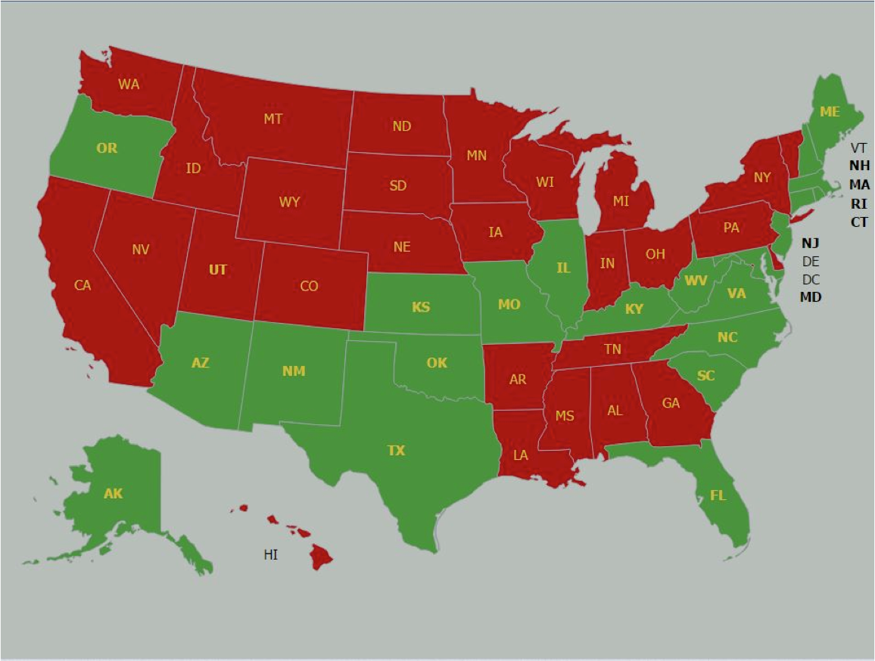
22 State Tuition Waiver Programs for Foster Youth
http://www.tipwaynestate.org/interactive-tuition-waiver-map.html
Notes:
Several steps have been taken to address postsecondary education disparities among foster youth. The education and training voucher (ETV) was the first federal program specifically created to promote college access among current and former foster youth. You are going to hear more about that initiative from our colleagues in the room today. The tuition waiver is another growing financial aid resource developed by states to support college attendance and address the educational deficits of foster care youth. To date, 22 states have created tuition waiver programs that target current and former foster care youth (Hernandez, Day, & Crosby, 2015). Tuition waivers are state funded programs that increase access to higher education for young people currently and formerly in foster care by “waiving” their tuition and fees at public colleges and universities under certain conditions.

Slide 8
Best Practices of Tuition Waivers
Allow Part-Time Status
Siblings also eligible (MD)
Expand eligibility to tribal children (OR)
Expand eligibility for adoption and guardianship cases
TX youth can use waiver indefinitely but must take a class by age 25
CT covers tuition, fees, and room & board out of state, (Up to $27,630)
Recommendations
No age limit for youth to apply
No age for eligibility (ME& WV)
No time limit in foster care
No restrictions on waiver use

Slide 9
Texas Tuition Waiver
Only State to extend eligibility to
A child who exits TX conservatorship and returns to biological parent even after termination of parent’s rights
No Age limit once the waiver is activated before age 25. Waiver can be used for graduate education.
Any Student must Enroll in Waiver class at any public university before 25th birthday to access waiver
The undergraduate student must access the tuition and fee waiver prior to the age of 25.
Texas
https://www.dfps.state.tx.us/Child_Protection/Youth_and_Young_Adults/Post_Secondary_Education/college_tuition_waiver.asp
Notes:
Texas is the only State that has no Age limit once the waiver is activated before age 25. the tuition waiver can be used for graduate school.

Slide 10
Connecticut Post Secondary Education Assistance
Age & Time Limit
Must use the waiver by 21st birthday
And can continue to use it until age 23.
Student must contribute $500 to educational costs per year.
Each semester provides documentation of enrollment/grades.
2.0 minimum GPA
Assistance includes:
Tuition, fees, books, room & board equal to the cost of Univ of Conn Storrs Campus- $7,029
Summer classes can be covered.
CT Post Secondary Education Assistance
http://www.ctfosteradopt.com/fosteradopt/cwp/view.asp?Q=447946&a=3795#CAPSCEA
Notes:
CT is the only state to include room and board in their tuition waiver assistance-
http://admissions.uconn.edu/cost-aid/tuition

Slide 11
Maryland Tuition Waiver
Unaccompanied homeless youth who qualifies as an independent student
Must be enrolled in a university before age 25.
Can be used until the youth receives a bachelors degree or 5 years after college enrollment
MD Tuition Waiver for Foster Care Receipients
http://mhec.maryland.gov/preparing/Pages/FinancialAid/ProgramDescriptions/prog_fostercare.aspx
Eligibility Requirements
Resided in foster care at the time of HS graduation or the time of receiving a GED
Resided in OOHC on 18th b-day or
Was placed into guardianship or adoption after age 13
Includes a younger sibling also placed in the same adoptive or guardianship home. (only state to include this)
Notes:
Maryland was the only state we found to allow: a younger sibling also placed in the same adoptive or guardianship home to be eligible for GAP.
Maryland is one of only a few states including NJ who allows homeless youth to also be eligible for the tuition waiver.
http://mhec.maryland.gov/preparing/Pages/FinancialAid/ProgramDescriptions/prog_fostercare.aspx
Students must file FAFSA annually &
Be enrolled full or part time for a college degree
Does not cover room & board, books, transportation.
Maintain satisfactory academic progress

Slide 12
History of Tuition Waivers
Year Implemented | State
1988 | Florida
1993 | Texas
1994 | Connecticut
1999 | Kentucky, Maine
2000 | Massachusetts, Rhode Island, Virginia
2007 | Maryland
2012 | Oregon
Other Subpopulations
Veterans, Coast Guard,
Law Enforcement, Firefighters, EMT, Surviving Spouse or Child
Teachers, Nurses
Blind, Deaf Students
Adopted & Kinship youth

Slide 13
BiPartisan Support of Tuition Waivers
13 States had divided governor/legislatures: (FL, CT, MN, OK, MA, ME, RI, WV, NJ, MD, MO, OR, NM)
13 states had a Republican governor. (CT, MN, OK, MA, RI, VA,WV, KS, AK,MD, SC, AZ, NM)
8 states had a Democratic Governor. FL, TX, KY, NJ, NH, NC, MO, OR. (ME- Independent Gov.)
13 Democratic Legislatures were in place at the time of waiver implementation.
4 states had both Rep Gov/Legis: AK, AZ, KS, VA
4 states had both Dem Gov/Legis: TX, KY, NH, NC
Notes:
Analysis restricted to programs with state legislation or policies authorizing tuition waivers in operation over the 2014-2015 academic year.
Other states have private scholarships- or other grants not included in this analysis
Only 4 states had both rep governor and legislatures at the time this passed: AK, AZ, KS and VA

Slide 14
Number of Waivers & Cost in 2014
Only 6 states had totals of 100-500 waivers awarded
10 states had less than 100 youth who received waivers.
4 states had no data on # of waivers. (KY, NJ, NM, WV)
#Students | State | Cost
973 waivers granted of 4,739* eligible | Florida
3,195 | Texas | $8,389,635 foregone tuition
488 | Connecticut | $4,143,303
353 | Massachusetts
335 | North Carolina | $1,928,490
106 | Maryland
47 | Oregon | $64,130

Slide 15
Age & Time in Care Requirements
2 States have no Age requirement
6 states - be over age 16
11 states –student 18yrs old
10 States have no Time
State | Age | Time in Care
Maryland | 13 (if adopted, 18 otherwise)
Oregon | After 16 | Be in care, or was in care for 6 months before age 16
Texas | 1 day before 18th bday
Notes:
Maryland –youngest age requirement

Slide 16
Age for Waiver Application
5 states require youth to apply for the Waiver prior to age 21
4 states allow youth to apply for the Waiver between the ages of 23-24.
6 states require youth to apply before age 25.
2 states require youth to apply within 2-3 years after graduating from HS.
http://www.tipwaynestate.org/policy-projects.html

Slide 17
Implications for Policy & Practice
1) Tuition waivers vary drastically in terms of eligibility for participation across states.
2) Outcome data on program effectiveness of Waivers are lacking
3) Waiver programs should link their data with the National Student Clearinghouse as a cost-effective and efficient way to address the data gap
4) Youth in foster care take 7 yrs to graduate with a Bachelor degree, 1 year longer than other low income first generation students.
Many Foster Youth at Risk of losing access to Federal Pell Grants BEFORE graduation
Pell Grants expire after12 semesters – 6 years if they do not use Pell Grants for summer classes;
Tuition waiver programs are often last dollar programs, and waiver dollars are limited in many states that offer them.
Both the Higher Education Act & the Chaffee Act are up for reauthorization this year. There are opportunities to strengthen Financial Aid Policies to support the college going efforts of FY.
Need for effective outreach and increased funding for the Chafee ETV

Slide 18
HR 253 Family First Prevention Services Act of 2017 HR 2847 Improving Services for Older Youth in Foster Care Act
Both of these bills would revise the
John H. Chafee Foster Care Independence Program to:
Allow states that extend foster care eligibility up to age 21 to extend assistance and services to youth who have aged out of foster care but have not yet reached age 23
Authorize redistribution of unexpended Chafee amounts to other states
Allow youth to be eligible for Educational and Training Voucher program through age 25 (but no more than 5 years)
Notes:
253 reintroduced by Rep. Buchanan, Vern [R-FL-16] and Sander Levin (MI-D) from the previous congress- strong bipartisan support in the House, hurdles to be overcome in the Senate. House pledged to pass the bill if the Senate takes it up. Possible Interest in pushing this bill through CHIP reauthorization.
2847- FASO , Reed, and Bass introduced in June 2017. Passed the house and now referred to Senate Finance Committee. Same exact provision as was in families first. This was not a controversial provision in Families First, and the thought from the House is that although there is support for the larger FF bill, it might be better to pass smaller, but extremely meaningful provisions from within FF, than nothing at all.

Slide 19
S. 1795/HR 3740 (115th) Higher Education Access and Success for Homeless and Foster Youth Act
Amends the Higher Education Act of 1965
With respect to a student's independence for purposes of financial aid, a financial aid administrator must: (1) accept a homelessness determination made by an authorized individual; and (2) make such a determination if the student cannot get documentation from a designated authority. A student determined to be independent on this basis shall be presumed independent for a subsequent award year at the same institution.
To be eligible for certain federal funds, a university must meet specified requirements related to student housing, coordination, and notice of financial assistance eligibility for homeless and foster care students.
Notes:
Murray/Clark bill
One republican on the HR bill (Rep. Young, Don [R-AK-At Large])
New bill # pending for reintroduction in the 115th Due out Sept 12th

Slide 20
S. 1795/HR 3740 (115th) Higher Education Access and Success for Homeless and Foster Youth Act
The Department of Education shall require an entity to make specified assurances such as prioritizing federal work-study children and youth who are homeless or in foster care.
For purposes of income-based financial aid determinations, the bill excludes from income: (1) the value of specified vouchers for education and training, and (2) direct payments made through an extended foster care program.
For children or youth who are homeless or in foster care, colleges will only be allowed to charge them in-state tuition rate.
Notes:
Murray/Clark bill
One republican on the HR bill (Rep. Young, Don [R-AK-At Large])
New bill # pending for reintroduction in the 115th Due out Sept 12th

Slide 21
HR 3742/S 1792 Fostering Success in Higher Education Act of 2017
Amends the Higher Education Act of 1965 to:
$125 million a year to states/tribes establish or expand statewide initiatives that assist foster and homeless youth in enrolling and graduating college
Establishes formula grants to states based on state’s share of foster and homeless youth among all 50 states, tribes and territories with a $500,000 minimum grant
Dedicates 70% of state grants to develop institutions of excellence committed to serving foster and homeless youth via robust support services and substantial financial assistance, in collaboration with Child Welfare and organizations serving homeless, by providing comprehensive wraparound services, hiring FT “campus coach”, and ensuring student health and mental health services
Directs 20% state grants to establish intensive, statewide transition initiatives to increase understanding, preparation and application of foster and homeless youth in college
Provides 7% of funds for technical assistance and evaluation to inform best practice/Reserves 5% funds to tribes
Notes:
Bills to be introduced by Davis and Franken Sept 12
These bills designed to complement the Murray/Clark bill with goal of introducing and pushing them through as a package.

Slide 22
Review of Research on Postsecondary
Educational Attainment
 | Foster Care | Non-Foster Care
Community College | 43% | 29%
19-year olds pursuing a 4 year degree | 18% | 62%
25-year olds with a bachelor’s degree | 3% | 24%
College students who have earned a degree within 6 years of enrollment | 26% | 56%
Time to graduation | 7 years Up to 21semesters | 6 years 12 semesters

Slide 23
Identifying Foster Care students through the FAFSA Independent Status
Finding Admitted Students
FAFSA Q53:(in section 2) on the Free Application for Federal Student Aid asks: "At any time since you turned age 13, were both of your parents deceased, were you in foster care or were you a dependent or ward of the court?
FAFSA Q54: Are you an accompanied youth who is homeless or self supporting and at risk of being homeless?
Addressing Enrollment Barriers
College Admission Applications ask if a student had been in foster care. (Ex. Wayne State College Application Question)
Were you in foster care on or after your 13th birthday in the state of Michigan?
Michigan child welfare agency has a data sharing agreement with universities to electronically verify if a student had been in foster care.
Notes:
Including question on the admission application allows for maximizing student enrollment by providing opportunity for schools to assist students to ensure they successfully complete the enrollment process so they have the best chance at being successfully admitted.

Slide 24
Citations
Liliana Hernandez, Angelique Day & Michael Henson (2017): Increasing College Access and Retention Rates of Youth in Foster Care: An Analysis of the Impact of 22 State Tuition Waiver Programs. Journal of Policy Practice,
DOI: 10.1080/15588742.2017.1311819
Tuition Waiver Brief
State ETV website links
http://www.tipwaynestate.org/policy-projects.html
Interactive Tuition Waiver Map
http://www.tipwaynestate.org/interactive-tuition-waiver-map.html

Slide 25
Federal References
Children’s Bureau Education Stability Webpage includes Guidance on Every Student Succeeds Act
https://www.childwelfare.gov/topics/systemwide/service-array/education-services/meeting-needs/educational-stability/
Department of Education Students in Foster Care
http://www2.ed.gov/about/inits/ed/foster-care/index.html
Providing Effective Financial Aid Assistance to Students from Foster Care and Unaccompanied Homeless Youth http://calswec.berkeley.edu/files/uploads/pdf/CalSWEC/EdRights_ProvidingEffectiveFinancialAid.pdf

Slide 26
Foster Care Extension to 21
Chafee Legislation/Child Welfare Policy Manual: https://www.acf.hhs.gov/cwpm/programs/cb/laws_policies/laws/cwpm/policy.jsp?idFlag=3
23 States receive Fed & State funding to 21 (includes WI)
48 States extend Foster Care past age 18, usually for students still completing HS up to age 19. http://www.tipwaynestate.org/policy-projects.html
Casey State Policy Database: http://www.childwelfarepolicy.org/maps/single?id=85

Slide 27
Thank You!!!
Angelique Day, PhD
Assistant Professor
University of Washington, School of Social Work
dayangel@uw.edu
For more information: http://depts.washington.edu/fostered/policy
Liliana Hernandez, MSW/MPP
Virginia Family and Children’s Trust Fund
Mslhernandez@gmail.com

